Slide 1
Digital Circuits and Logic Design
Chapter 1
Introductory Concepts

Slide 2
After this lecture, you should be able to:
Explain what are digital and analog quantities
Explain the reasons for using digital circuits
Describe property of periodic pulse waveforms

Slide 3
Analog Quantities
Analog quantity (模拟量)
- one having continuous (连续的) values.
Most natural quantities are analog and vary continuously.

Slide 4
Analog Quantities
Analog quantity
Physical quantities
Temperature (温度)
pressure (压力)
time (时间)
velocity(速度)
sound (声音)

Slide 5
Digital Quantities
A digital quantity (数字量)
- one having a discrete (离散的 )set of values.

Slide 6
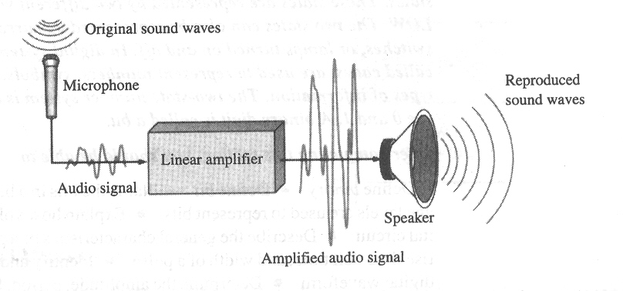
Analog Systems
An analog electronic system (模拟电子系统)
- a public address system

Slide 7
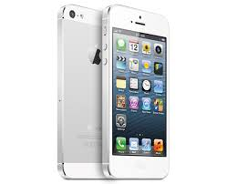



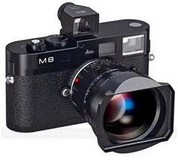
Digital Systems
Now most of modern electronic devices and systems are digital system.

Slide 8
Analog and Digital Systems
Analog and Digital Systems (模拟和数字混合电子系统)
Many systems use a mix of analog and digital electronics to take advantage of each technology.

Slide 9
ADC and DAC
ADC and DAC
Music in digital form is stored on the CD.
DAC: digital-to-analog converter (数模转换器)
Analog signal is obtained from the CD.
ADC: analog-to-digital converter(模数转换器)

Slide 10
Binary Digits
Digital electronics : 2 possible states.
2 states:
(1) 2 different voltage levels: HIGH and LOW.
(2) switch: open and close.
(3) lamp: turned on and off.
(4) 2 opposite states.

Slide 11
Binary Digits
The two-state number system is called binary(二进制）, and its two digits are 0 and 1.
Positive logic (common) (正逻辑）:
HIGH=1 and LOW=0.
Negative logic (负逻辑）
(less common):
HIGH=0 and LOW=1
Logic 0 | Logic 1
False | True
Off | On
Low | High
No | Yes
Open switch | Closed switch

Slide 12
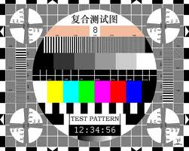
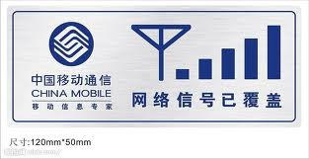

Signal
Signal(信号)

Slide 13

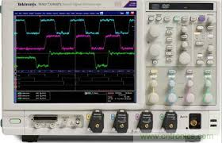

Signal
Signal

Slide 14
Logic Levels
Logic levels (逻辑电平)
-the voltages used to represent a 1 and a 0
The figure illustrates the general range of LOWs and HIGHs for a digital circuit.
V_{H(max)}
In binary, a single number is called a bit (for binary digit).
A bit can have the value of either a 0 or a 1, depending on if the voltage is HIGH or LOW.
HIGH
V_{H(min)}
Invalid
V_{L(max)}
LOW
V_{L(min)}

Slide 15
Digital Waveforms
Digital waveforms (数字波形)
Digital waveforms change between the LOW and HIGH levels. A positive going pulse is one that goes from a normally LOW logic level to a HIGH level and then back again.
Digital waveforms are made up of a series of pulses.
下降沿或后沿
上升沿或前沿
上升沿或后沿
下降沿或前沿

Slide 16
Digital Waveforms
Pulse definitions (脉冲)
Actual pulses are not ideal but are described by the rise time, fall time, amplitude, and other characteristics.
超调量
振荡
下调
幅度
脉冲宽度
基线
下调量
上升时间
下降时间

Slide 17
Digital Waveforms
Periodic Pulse Waveforms (周期脉冲波形)
Periodic pulse waveforms are composed of pulses that repeats in a fixed interval called the period(周期) .
The frequency(频率) is the rate it repeats and is measured in hertz.
The clock (时钟) is a basic timing signal that is an example of a periodic wave.
What is the period of a repetitive wave if f = 3.2 GHz?

Slide 18
Digital Waveforms
Pulse Definitions
In addition to frequency and period, repetitive pulse waveforms are described by the amplitude (幅度A) , pulse width (脉宽t_{W}) and duty cycle (占空比).
Duty cycle is the ratio of t_{W} to T.
Amplitude (A)
Pulse width (t_{W})
Period, T

Slide 19
Digital Waveforms
Timing Diagrams (时序图)
A timing diagram is used to show the relationship between two or more digital waveforms
Logic Analyzer

Slide 20
Data Transfer
Serial and Parallel Data (串行和并行)
Data can be transmitted by either serial transfer or parallel transfer.

Slide 21
Advantages of Digitals
Advantages
Can be processed and transmitted more efficiently and reliably
Easy to be stored, and can be stored more compactly and so on
Can’t be affected by noise (unwanted voltage fluctuations)

Slide 22
Basic Logic Functions
Basic Logic Functions(基本逻辑函数)
AND
True only if all input conditions are true.
OR
True only if one or more input conditions are true.
NOT
Indicates the opposite condition.

Slide 23
Basic Logic Functions
Basic Logic Functions
And, or, and not elements can be combined to form various logic functions
The comparison function
Basic arithmetic functions

Slide 24
Basic Logic Functions
Basic Logic Functions
The encoding function
The decoding function

Slide 25
Basic Logic Functions
Basic Logic Functions
The data selection function

Slide 26
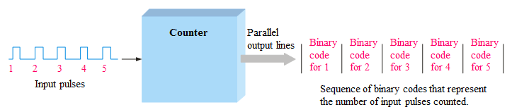
Basic Logic Functions
Basic Logic Functions
The counting function

Slide 27
Basic Logic Functions
Basic Logic Functions
The storage function

Slide 28
Fix-Function Integrated Circuits
IC Packages(封装)
Cutaway view of DIP (Dual-In-line Pins) chip:

Slide 29
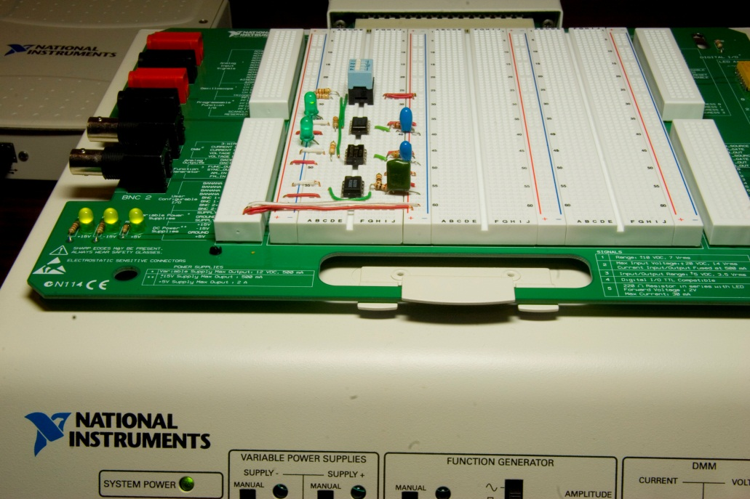
Fix-Function Integrated Circuits
IC Packages
An example of laboratory prototyping is shown. The circuit is wired using DIP chips and tested.
DIP chips

Slide 30
Fix-Function Integrated Circuits
IC Packages
DIP chips and surface mount chips
Pin 1
Dual in-line package Small outline IC (SOIC)
双列直插封装
小尺寸封装

Slide 31
Fix-Function Integrated Circuits
IC Packages
Other surface mount packages
SOIC PLCC LCCC
小尺寸封装
有引线塑料芯片载体
无引线陶瓷芯片载体

Slide 32
Programmable Logic Devices
Programmable Logic Devices(可编程逻辑器件)
The logic can be programmed for a specific purpose.
In general, they cost less and use less board space that fixed
function devices.
A PAL device is a form of PLD that uses a combination of a programmable AND array and a fixed OR array

Slide 33
Test and Measurement Instruments
Oscilloscope(示波器)

Slide 34
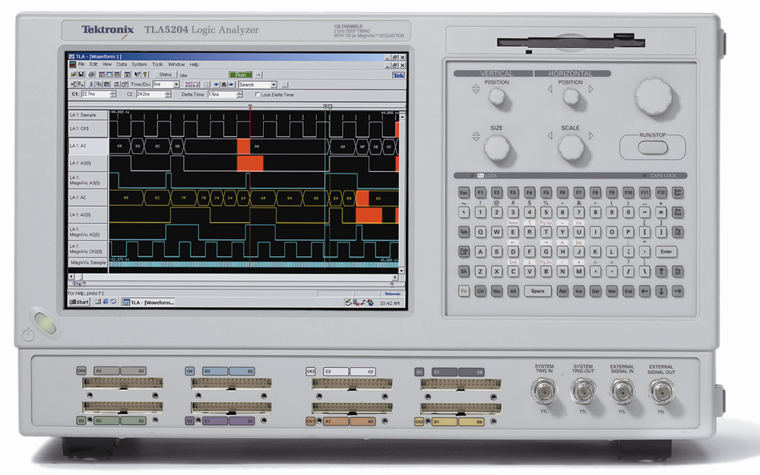
Test and Measurement Instruments
Logic Analyzer(逻辑分析仪)

Slide 35
Test and Measurement Instruments
Digital Multimeter(数字万用表)
The DMM can make three basic electrical measurements
Voltage
Resistance
Current
0.01 V

Slide 36
Quiz
1. Compared to analog systems, digital systems
a. are less prone to noise
b. can represent an infinite number of values
c. can handle much higher power
d. all of the above
2. The number of values that can be assigned to a bit are
a. one
b. two
c. three
d. ten

Slide 37
Quiz
3. The time measurement between the 50% point on the leading edge of a pulse to the 50% point on the trailing edge of the pulse is called the
a. rise time
b. fall time
c. period
d. pulse width
4. The time measurement between the 90% point on the trailing edge of a pulse to the 10% point on the trailing edge of the pulse is called the
a. rise time
b. fall time
c. period
d. pulse width

Slide 38
Quiz
5. The reciprocal of the frequency of a clock signal is the
a. rise time
b. fall time
c. period
d. pulse width
6. If the period of a clock signal is 500 ps, the frequency is
a. 20 MHz
b. 200 MHz
c. 2 GHz
d. 20 GHz

Slide 39
Quiz
7. AND, OR, and NOT gates can be used to form
a. storage devices
b. comparators
c. data selectors
d. all of the above
8. A shift register is an example of a
a. storage device
b. comparator
c. data selector
d. counter

